Slide 1
Warm Up Question
How many rows would the following queries return?
{t.a, t.b | AA(t) and ((∃s) (BB(s) and s.b = t.a))}
{t.a, s.f | AA(t) and BB(s) and t.c=3}
What are in the rows?
AA
BB
a | b | c
1 | 4 | 3
5 | 5 | 3
6 | 5 | 7
b | d | e | f
5 | 6 | 7 | 8
6 | 6 | 7 | 7
a | b
5 | 5
6 | 5
a | f
1 | 8
1 | 7
5 | 8
5 | 7
CS3319

Slide 2
Enhanced Entity-Relationship Diagrams and Object Modeling
Topic 7
Readings:
Chapter 8 (8.1-8.3.2) & 9, Enhanced Entity-Relationship Diagrams
CS319

Slide 3
TOPICS
Entities as Objects
EER Diagrams
Generalization
Specialization
Mapping EER diagrams to relational databases
CS319

Slide 4
Entities as Objects
If we think of entities as objects, then the entity type is an object class.
Then we can introduce subclasses to enhance our data modeling.
Just as with OO programming, subclasses inherit properties from their superclass
In the database case, they inherit all the attributes and relationships.
The methods in a database system are all predetermined by the query language definition, i.e. we can extend the structural part of the data structures but not the procedural part.
CS319

Slide 5
Example:
SSN
BDate
Name
Address
Employee
d
TypingSpeed
Tgrade
EngType
Technician
Engineer
Secretary
CS319

Slide 6
The Enhanced in Enhanced ER Diagrams (EER Diagrams) means we have ER diagrams with inheritance.
The U on the line from Secretary to the d node indicates that the set of all instances of Secretary is a subset of the set of instances of Employee.
The d in the node indicates that these three subsets (Secretary, Technician and Engineer) are disjoint
CS319

Slide 7
Example
Secretary
e1
e3
Employee
e1
e2
e3
e4
e5
e6
…
Technician
e4
Engineer
e2
e6
The above example shows partial participation in the inheritance, i.e. only some employees belong to one of the subclasses (e.g. e5 doesn’t).
CS319

Slide 8
If all Employees must belong to a subclass, then it is called total, and is indicated by a double-edge, as below:
SSN
BDate
Name
Address
Employee
d
Salary
PayScale
HourlyEmployee
SalariedEmployee
CS319

Slide 9
Generalization
The opposite of Specialization is Generalization
Example: Suppose you are modeling vehicles:
VehicleID
NoOfPassengers
Price
Price
VehicleID
Car
Truck
NoOfAxels
LicensePlateNo
LicensePlateNo
CS319

Slide 10
And you realize that it makes sense to have a superclass containing the common attributes:
Price
VehicleID
LicensePlateNo
Vehicle
d
NoOfAxels
NoOfPassengers
Truck
Car
CS319

Slide 11
Sometimes the instances of the subclasses overlap – indicated with an o in the circle
Example:
Person
o
Employee
Alumnus
Student
CS319

Slide 12
Can use a category to indicate which subclass an instance belongs too
Example:
SSN
BDate
Name
Address
Employee
JobType
JobType
d
“secretary”
“engineer”
TypingSpeed
EngType
Tgrade
“technician”
Engineer
Secretary
Technician
In this case, a trigger could insert a new employee into the appropriate subclass based on the value of JobType.
CS319

Slide 13
Notes
Help to make the conceptual model more accurate (but can cause clutter)
If subclass has few attributes and no relationships, might want to merge into superclass (specific attributes would be null for entities not a member of the subclass)
The default for disjoint/overlapping and total/partial is overlapped/partial (only put disjoint and/or total if it makes sense)
CS319

Slide 14
Question
Consider the following entity sets and attributes. Place a checkmark in one column in each row to indicate the relationship.
Entity Set | Has a relationship with | Has an attribute that is | Is a specialization of | Is a generalization of | Entity Set or Attribute
Mother |  |  |  |  | Person
Daughter |  |  |  |  | Mother
Student |  |  |  |  | Person
Student |  |  |  |  | StudentNumber
School |  |  |  |  | Student
Animal |  |  |  |  | Horse
Horse |  |  |  |  | Age
Furniture |  |  |  |  | Chair
Hint: use the “IS A” Rule to help decide!
CS3319

Slide 15
Mapping EER Diagrams to Relations:
In Lecture 2, we introduced 7 steps.
Now we add Step 8:
Step 8: Convert each specialization with m subclasses {S₁, S₂, … S_{m}} and (generalized) superclass C, where the attributes of C are {k, a₁, … ,a_{n}} and k is the (primary) key, into relations schemes using one of the four following options:
CS319

Slide 16
Option 8A Multiple relations – superclass and subclasses: Create a relation L for C (superclass) with attributes = {k, a₁, … ,a_{n}} and primary key = k. Create a relation L_{i} for each subclass S_{i}, 1 <= i <= m, with the attributes of L_{i} = {k} U {attributes of S_{i}}, and primary key of L_{i} = k.
CS319

Slide 17
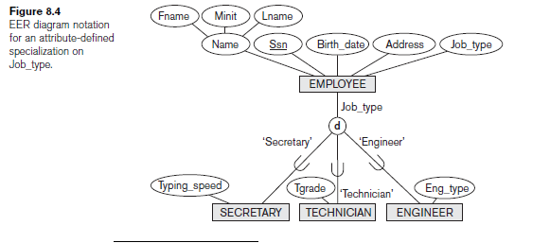
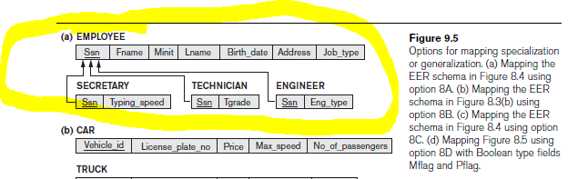
Mapping Examples
CS319

Slide 18
Option 8B Multiple relations – subclass relations only: Create a relation L_{i} for each subclass S_{i}, 1 <= i <= m, with the attributes {attributes of S_{i}} U {k, a₁, … ,a_{n}} and primary key for each L_{i} = k. (i.e. do not have a relations for C).
Note: this option could cause redundant data ☹
CS319

Slide 19
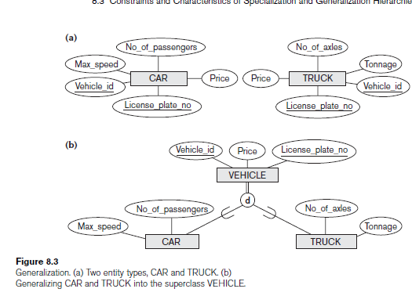
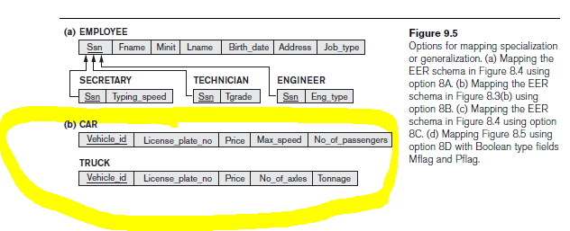
CS3319

Slide 20
Option 8C Single relation with one type attribute: Create a single relation L with attributes {k, a₁, … ,a_{n}} U {attributes of S₁} U … U {attributes of S_{m}} and primary key = k.
This option is for disjoint subclasses, with a discriminating attribute or category, and has the potential for generating a large number of null values.
CS319

Slide 21
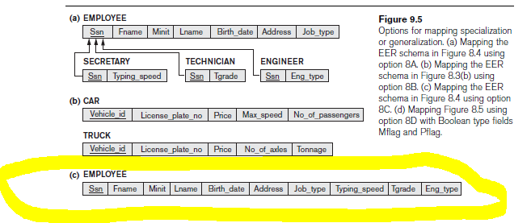
CS3319

Slide 22
Option 8D Single relation with multiple type attributes: Create a single relation L with attributes {k, a₁, … ,a_{n}} U {attributes of S₁} U … U {attributes of S_{m}} U {t₁, t₂, …, t_{m}} with primary key k.
This option is for overlapping subclasses, and each t_{i}, 1 <= i <= m, is a Boolean attribute indication whether this tuple belongs to subclass S_{i}.
CS319

Slide 23
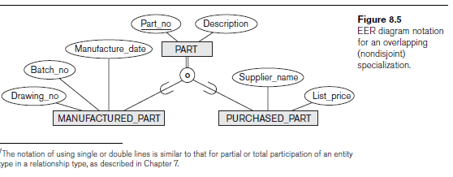
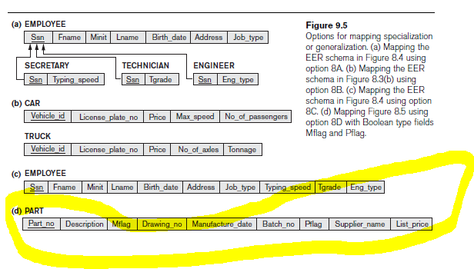
CS3319

Slide 24
Another Example:
City Hall is trying to classify it's buildings for taxing purposes.
  Every building has an address and a unique building code and the owners name.
  A building must be either a private residence or business, but it cannot be both.
  For a private residences, city hall wants to also keep track of the number of bedrooms and number of bathrooms.
  For a business, they want to keep track of the number of exits, size of the property, and the number of parking spots.
CS319

Slide 25
QUESTION: Draw an EER diagram to reflect this example:
BuildingCode
OwnerName
Address
Building
d
NumOfParkingSpots
NumOfExits
NumOfBedrooms
NumOfBathrooms
BusinessBuilding
PrivateResidence
Size
CS319

Slide 26
Map your EER diagram to relational table(s):
BusinessBuilding
BuildingCode | OwnerName | Address | Size | NumOfParkingSpots | NumOfExits
PrivateResidence
BuildingCode | OwnerName | Address | NumOfBedrooms | NumOfBathrooms
CS319

